Slide 1
Collision Detection
Introduction to Game Design and Development
ITCS 4230/5230
Dr. Dewan Tanvir Ahmed
Department of Computer Science
University of North Carolina at Charlotte

Slide 2
Introduction
Collision Detection is an important problem in many fields
Game programming
Computer animation
Virtual reality
The problem:
The search for intersecting planes of different 3D models in a scene.

Slide 3
Problem Definition
The problem can be defined as if two objects intersect and where and when.

Slide 4
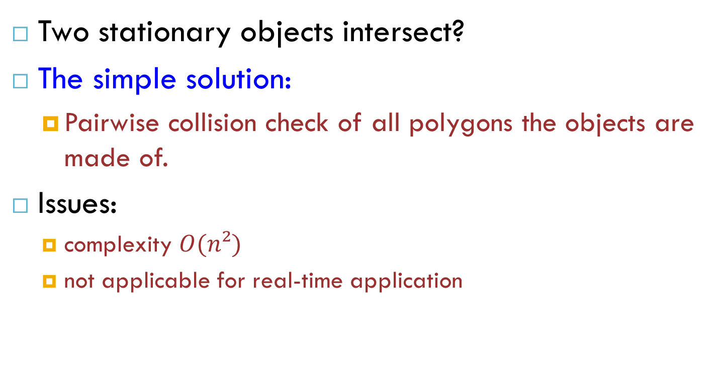
Basic Problem
Two stationary objects intersect?
The simple solution:
Pairwise collision check of all polygons the objects are made of.
Issues:
complexity $O(n²)$
not applicable for real-time application

Slide 5
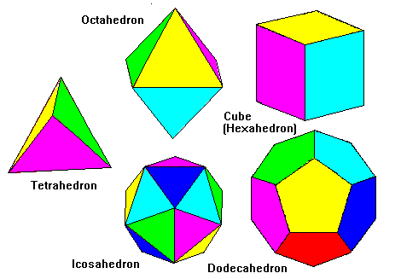
Polyhedron
A polyhedron (plural polyhedra or polyhedrons)
is a solid in three dimensions with flat polygonal faces, straight edges and sharp corners or vertices.

Slide 6
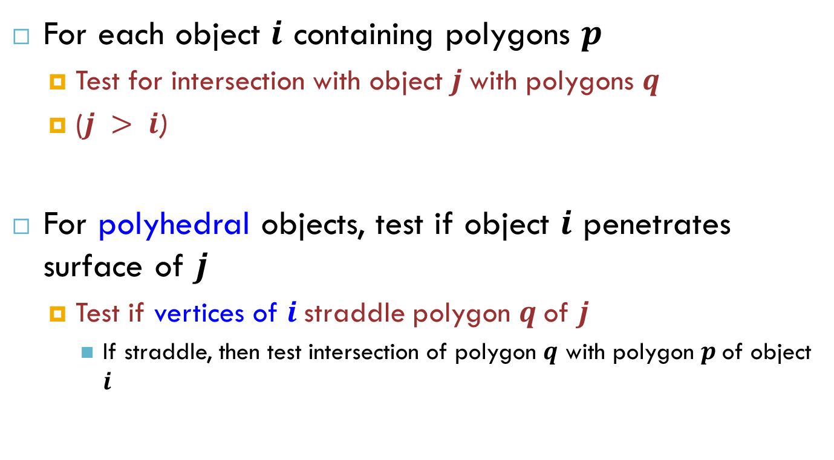
Collision Detection
For each object $i$ containing polygons $p$
Test for intersection with object $j$with polygons $q$
($j > i$)
For polyhedral objects, test if object $i$ penetrates surface of $j$
Test if vertices of $i$straddle polygon $q$of $j$
If straddle, then test intersection of polygon $q$ with polygon $p$of object $i$
Notes:
Cubes, pyramids and some toroids are examples of polyhedra

Slide 7
Pong Game
Quick and Dirty Collision Detection for Pong Game
Add bounding box to paddle
Add bounding box to ball
Optional: Add bounding box for walls
In update:
Check collisions with
Ball.boundingBox.Intersects(paddle (1, 2, wall, etc).boundingBox)

Slide 8
Intersection Testing: Sphere-Sphere Collision

Slide 9
Intersection Testing: Sphere-Sphere Collision
Smallest distance ever separating two spheres:
If
there is a collision

Slide 10

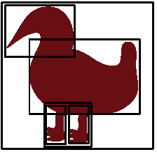
Efficiency hacks/cheats
Fewer tests: Exploit spatial coherence
Use bounding boxes/spheres
Hierarchies of bounding boxes/spheres

Slide 11
Collision Detection Math
Cheaper distance calculation:
Compare against
Approximation:
Manhattan distance - Shortest side/2

Slide 12


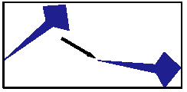
Bounding Boxes (BBox)
Axis-aligned vs. Object-aligned
Axis-aligned BBox change as object moves
Approximate by rotating BBox
Swept volume

Slide 13
Axis Aligned Bounding Box (AABB)
Ax, Ay
Bx, By
AX, AY
BX, BY
These boxes are separate if:
AX < Bx
BX < Ax
AY < By
BY < Ay
Boolean collide(A, B)
{ return !(AX < Bx || BX < Ax || AY < By || BY < Ay) }

Slide 14

Convex objects
Look for separating plane
Test all faces
Test each edge from obj 1 against vertex of obj 2
Save separating plane for next animation frame

Slide 15

Concave Objects
Break apart
Convex hull
Automatic or artist-created

Slide 16
Speed Ups
Sort on one dimension
Bucket sort (i.e. discretize in 1 dimension)
Exploit temporal coherence
Maintain a list of object pairs that are close to each other
Use current speeds to estimate likely collisions
Use cheaper tests

Slide 17
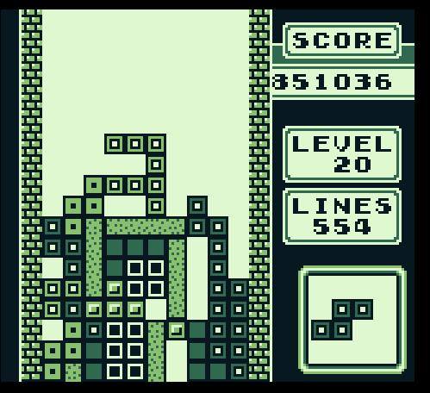
Let’s Talk About Tetris
ROSS
Likes
Dislikes
Improvements?

Slide 18
Questions?
Suggested Reading:
http://critical-gaming.blogspot.com/2008/07/how-to-write-critical-video-game-review.html
Suggested Viewing: (please note this is R rated for a reason)
http://www.escapistmagazine.com/videos/view/zero-punctuation

Slide 19
Thank you!

